Slide 1
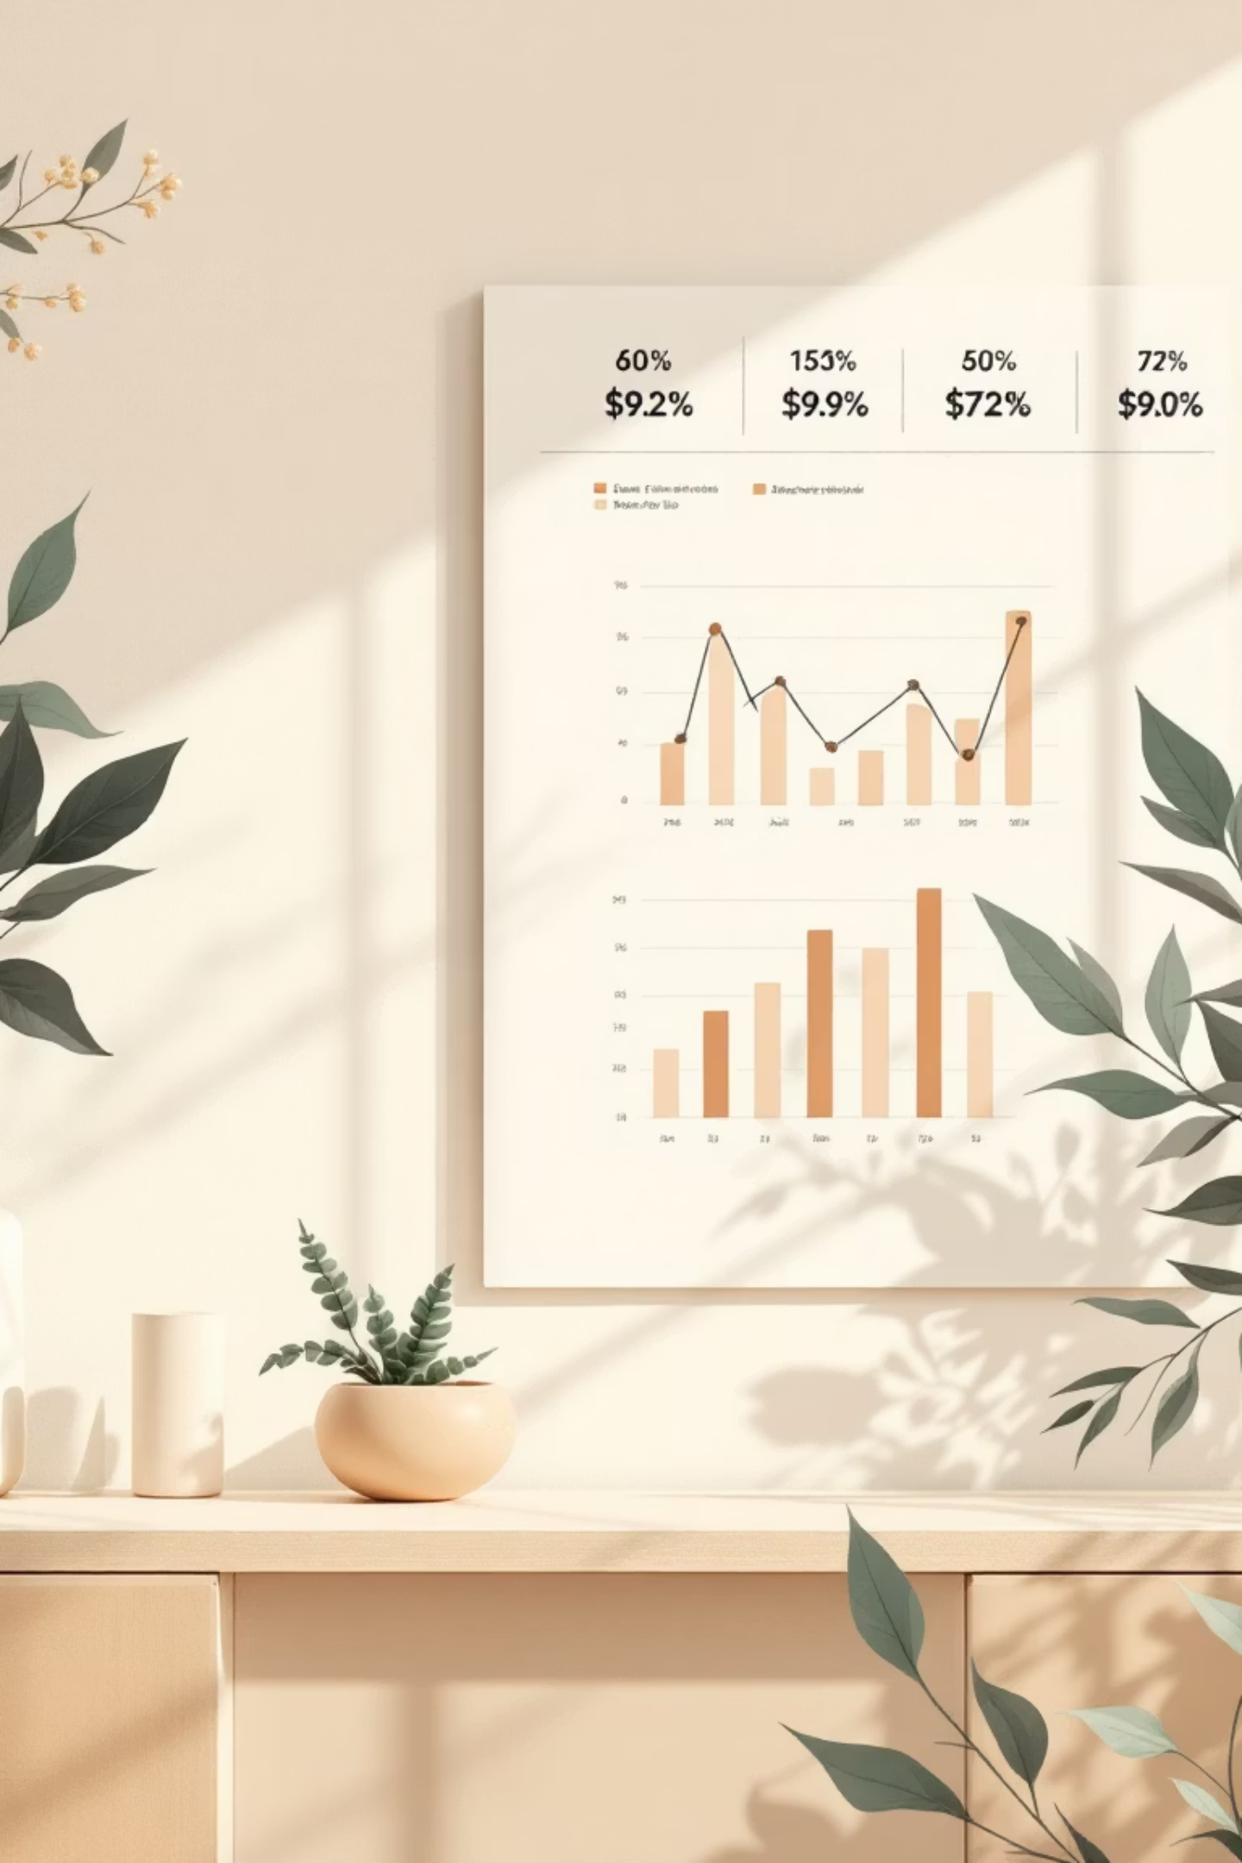
Customer Shopping Behavior Analysis
Understanding retail patterns through data-driven insights

Slide 2

Project Scope
End-to-End Analytics Pipeline
01
02
03
Python
SQL Server
Power BI
Data cleaning, preprocessing, feature engineering
Structured business analysis and segmentation
Interactive dashboards and storytelling
Analyzing 3,900 customer records across 18 features to uncover insights on retention, product optimization, and targeted marketing

Slide 3
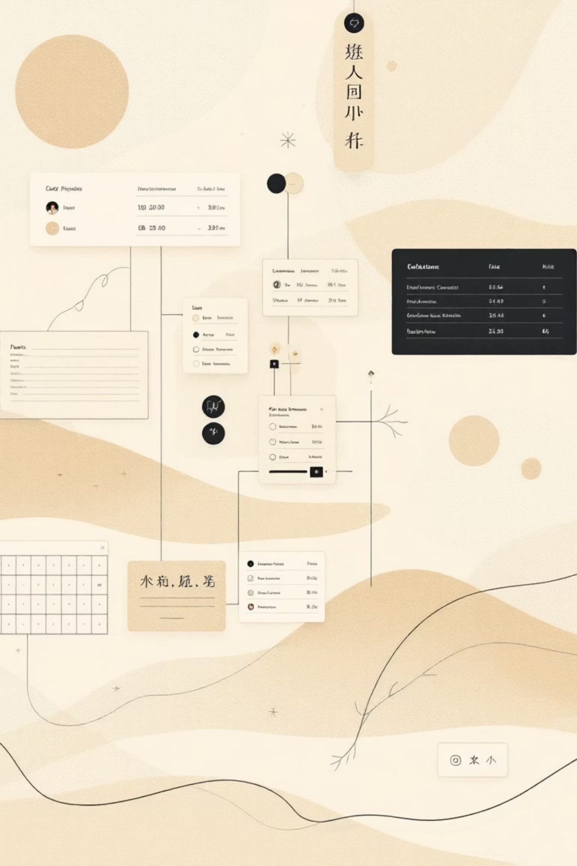
Dataset Foundation
Core Metrics
Feature Engineering
3,900 customer records
age_groupQuantile segmentation: Young Adult, Adult, Middle-Aged, Senior
18 feature columns
37 missing values (imputed)
Key Attributes
purchase_frequency_daysMapped textual frequency to numerical day counts
Demographics: Age, Gender, Location
Transactions: Purchase Amount, Category, Season
Behavior: Previous Purchases, Subscription Status

Slide 4

Revenue Drivers by Demographics
1
2
27%
Young Adults
Middle-Aged
Subscribers
Highest revenue generation and order frequency
Second-highest spending segment
Higher engagement despite smaller population
Key Finding
Purchase Frequency: Younger customers shop more frequently with shorter gaps between purchases
Female customers in Young Adult and Middle-aged groups show strongest price sensitivity and discount usage

Slide 5
Product Performance Insights
Blouse
Jewelry
Sneakers
Top repeat purchase item
High loyalty and ratings
Strong repeat appeal
Top Categories
Highest Rated
Seasonal Peak
Clothing, Accessories, Footwear dominate repeat purchases
Gloves, Sandals, Boots, Hat, Skirt lead satisfaction scores
Fall and Spring generate maximum revenue

Slide 6




Customer Segmentation Analysis
Loyal Customers
>10 purchases • Highest value • Smallest population
Returning Customers
2-10 purchases • Moderate spend • Growth potential
New Customers
1 purchase • Largest population • Conversion opportunity
Subscription Impact
Frequency Pattern
Customers with >5 previous purchases show significantly higher subscription adoption
Subscribers demonstrate shorter purchase intervals and return more often

Slide 7

Payment & Shipping Preferences
Payment Methods
Standard Shipping
Certain methods correlate with higher satisfaction and discount usage
Preferred by high-engagement customers, better ratings
Express Shipping
Higher average spend but opportunity for experience improvement
Review Ratings
Subscribers give slightly better average ratings, reflecting improved satisfaction and loyalty
Higher ratings correspond with higher purchase amounts

Slide 8
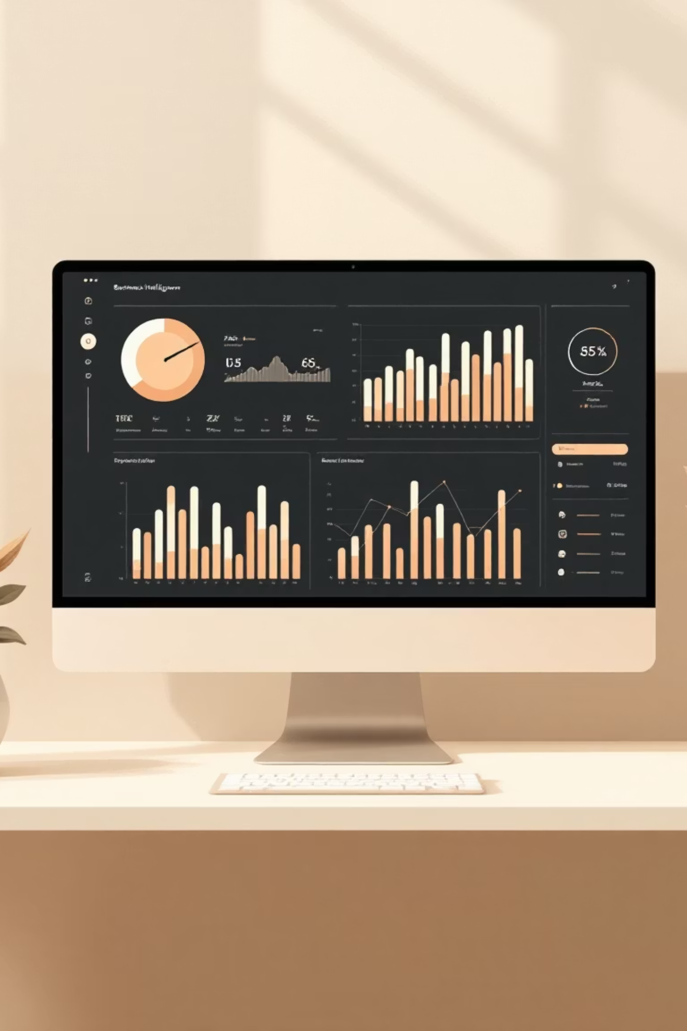


Power BI Dashboard Overview
Customer Overview
Demographics, behavior, segments, geographic distribution
Product Insights
Revenue, reviews, seasonal trends, category performance
Geographic Spread
Discount Impact
Category Satisfaction
Healthy mix of value-driven and convenience-driven buyers
Uneven distribution with certain states driving majority of revenue
Footwear and Accessories show strongest ratings

Slide 9

Strategic Recommendations
Strengthen Subscriptions
1
Introduce bundled perks and loyalty benefits to convert high-engagement customers
Enhance Loyalty Programs
2
Exclusive rewards and early access for repeat customers who drive majority revenue
Seasonal Optimization
3
Align campaigns and launches with Fall and Spring peak periods
Category Focus
4
Increase visibility and variety in Blouse, Jewelry, and Footwear categories

Slide 10

Key Takeaways
Target Demographics
Subscription Value
Young Adult and Middle-Aged segments drive highest revenue—focus marketing here
27% subscribers show higher engagement—expand subscription offerings
Product Winners
Clothing, Accessories, Footwear dominate—strengthen these categories
Dynamic Discounting
Shipping Excellence
Balance margins with frequency through targeted, strategic promotions
Improve Express delivery reliability to match Standard's satisfaction levels

